Slide 1
Dialogue Notation and Design
Interface Design Roadmap
Conceptual Design -what is the conceptual model? Physical Design - what physical environment? Interaction - Modes what styles are appropriate?

Slide 2
Conceptual Design what is the conceptual model?
Physical Design what physical environment?
Interaction Modes what styles are appropriate?
Navigation Design how is the interface structured?
Dialogue Design how to link interactions?
Information Presentation how to show feedback/results?
Screen Layout best grouping/structure/alignment?

Slide 3
Conceptual Design what is the conceptual model?
Physical Design what physical environment?
Interaction Modes what styles are appropriate?
Navigation Design how is the interface structured?
Dialogue Design how to link interactions?
Information Presentation how to show feedback/results?
Screen Layout best grouping/structure/alignment?
High-level to low-level, task-oriented refinement
Data and presentation-oriented sometimes better:
Task focus may suggest long tedious dialogues instead: compact and interactive data presentation

Slide 4
Navigation Design
Golden rules — the Where3What of navigation:
Where you are
Where you’re going (or what will happen)
Where you’ve been (or what has been done)
What you can do now

Slide 5
Golden rules — the Where3What of navigation:
Where you are
Where you’re going (or what will happen)
Where you’ve been (or what has been done)
What you can do now
Often, navigation is goal seeking:

Slide 6
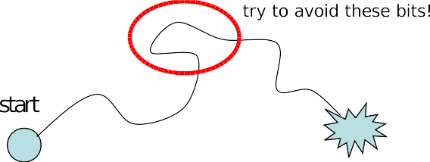

Slide 7
Different levels of structure, according to domain:
app: widgets; screens; application; environment
web: HTML; page layout; site; browser + www
device: controls; physical layout; modes; real world

Slide 8
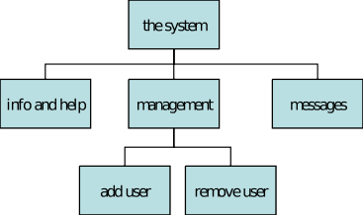
Static Structure Diagrams
Screen hierarchy
shows
structure/relationship
system-oriented
remember: deep is difficult!

Slide 9
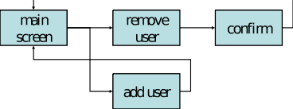
Navigation Network
show different paths through system
including branches
more task-oriented

Slide 10
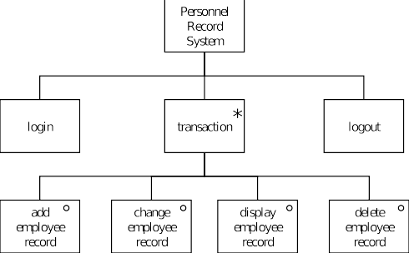
JSD Diagram
Old-fashioned technology and limited
but easily understood
close connection to HTA

Slide 11
Dialogue Design
Dialogue is the pattern of interaction between users and system
may be schematic (fill in blanks, e.g. names in wedding vows)
but course may change according to responses
In UIs, Dialogue Design:
refers to structure of interaction
often low-level (cf cognitive models)
not only conversing, also for instructing, manipulating, etc

Slide 12
Recall levels:
lexical: key or button presses/releases, icon shapes
syntactic: order of inputs/outputs
semantic: actual effect on application/data

Slide 13
Dialogue can get buried in the program or designed carelessly “on-demand”
Instead we may describe it alone, precisely using:
diagrammatic notations
textual notations
specific programming tools
Formal notations useful for testing, esp if executable

Slide 14
Also allow analysis, e.g., to find:
difficult to reverse actions
missing actions
inconsistent actions
unreachable or unrecoverable states
likely errors
To give semantics, descriptions can be linked (maybe mechanically) to behaviour or presentation.

Slide 15
Dialogue Notation Formalisms
State Transition Networks
€ graphical notation
€ easy to understand
€ limited expressivity
Grammars
€ textual
€ can be harder to understand
€ good expressivity
Process Calculi
€ textual, primarily
€ harder to understand
€ good expressivity, esp for concurrency

Slide 16
STNs
Like a finite state machine with I/O (a transducer)
€ edges are input events and resulting actions
Good for capturing sequential behaviour of dialogues
Poor at capturing concurrency, escape, errors
€ State or edge “blow up”
Diagrams can become cluttered and obscure
€ clutter: too many states, use hierarchical STNs
€ obscure: state names somewhat arbitrary

Slide 17
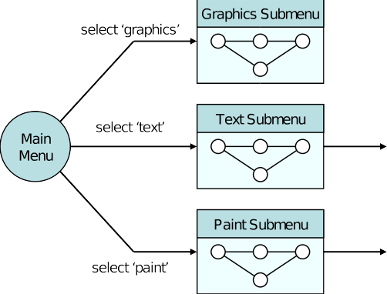
Combining all operations would give clutter
Simple structuring solves this, but what are the problems?

Slide 18
Grammar
Regular expressions useful for making compound actions, e.g.
e.g selectline + click + click∗ + doubleclick
Grammars may have cognitive validity
€ Still not good for concurrency, pervasive commands

Slide 19
Dialog Analysis
We can use descriptions to check some precise properties, of individual states or whole dialogue:
Completeness
€ What happens on event X in state Y?
Reversibility
€ How do we reverse action Z (e.g. “select line”)
€ . . . maybe navigation through dialog; not undo
Reachability
€ Can you get anywhere from anywhere?
€ How easily?
Dangerous states
€ Some states should be hard to get to
€ Perhaps guarded by warning dialogue
€ . . . although obvious problem if overused

Slide 20
We can also analyse descriptions informally:
check style guidelines, usability requirements
consider lexical syntax
€ differentiation and visibility of modes/states
€ verb-noun (menu style) versus noun-verb (direct)
€ physical layout (e.g. key sequence convenience, accidents)
€ not independent of dialogue
consider semantic intention
€ ways of attaching/checking semantics
€ maximising syntactic description

Slide 21
Visual Metaphors, Association, Analogy, Abduction and Blending
When a visual demonstration is used to understand an idea in terms of another familiar idea it is called a visual metaphor.
Visual analogy and conceptual blending are similar to metaphors. Analogy can be defined as an implication from one particular to another. Conceptual blending can be defined as combination of elements and vital relations from varied situations.
The HCI design can be highly benefited with the use of above mentioned concepts. The concepts are pragmatic in supporting the use of visual procedures in HCI, as well as in the design processes.

Slide 22
Direct Manipulation Programming
Direct manipulation has been acclaimed as a good form of interface design, and are well received by users. Such processes use many source to get the input and finally convert them into an output as desired by the user using inbuilt tools and programs.
“Directness” has been considered as a phenomena that contributes majorly to the manipulation programming. It has the following two aspects.
Distance
Direct Engagement

Slide 23
Distance
Distance is an interface that decides the gulfs between a user’s goal and the level of explanation delivered by the systems, with which the user deals. These are referred to as the Gulf of Execution and the Gulf of Evaluation.

Slide 24
The Gulf of Execution
The Gulf of Execution defines the gap/gulf between a user's goal and the device to implement that goal. One of the principal objective of Usability is to diminish this gap by removing barriers and follow steps to minimize the user’s distraction from the intended task that would prevent the flow of the work.
The Gulf of Evaluation
The Gulf of Evaluation is the representation of expectations that the user has interpreted from the system in a design. As per Donald Norman, The gulf is small when the system provides information about its state in a form that is easy to get, is easy to interpret, and matches the way the person thinks of the system.

Slide 25
Direct Engagement
It is described as a programming where the design directly takes care of the controls of the objects presented by the user and makes a system less difficult to use.
The scrutiny of the execution and evaluation process illuminates the efforts in using a system. It also gives the ways to minimize the mental effort required to use a system.

Slide 26
Problems with Direct Manipulation
Even though the immediacy of response and the conversion of objectives to actions has made some tasks easy, all tasks should not be done easily. For example, a repetitive operation is probably best done via a script and not through immediacy.
Direct manipulation interfaces finds it hard to manage variables, or illustration of discrete elements from a class of elements.
Direct manipulation interfaces may not be accurate as the dependency is on the user rather than on the system.
An important problem with direct manipulation interfaces is that it directly supports the techniques, the user thinks

Slide 27
Item Presentation Sequence
In HCI, the presentation sequence can be planned according to the task or application requirements. The natural sequence of items in the menu should be taken care of. Main factors in presentation sequence are −
Time
Numeric ordering
Physical properties

Slide 28
A designer must select one of the following prospects when there are no task-related arrangements −
Alphabetic sequence of terms
Grouping of related items
Most frequently used items first
Most important items first

Slide 29
Menu Layout
Menus should be organized using task semantics.
Broad-shallow should be preferred to narrow-deep.
Positions should be shown by graphics, numbers or titles.
Subtrees should use items as titles.
Items should be grouped meaningfully.
Items should be sequenced meaningfully.
Brief items should be used.

Slide 30
Consistent grammar, layout and technology should be used.
Type ahead, jump ahead, or other shortcuts should be allowed.
Jumps to previous and main menu should be allowed.
Online help should be considered.

Slide 31
Guidelines for consistency should be defined for the following components −
Titles
Item placement
Instructions
Error messages
Status reports

Slide 32
Form Fill-in Dialog Boxes
Appropriate for multiple entry of data fields −
Complete information should be visible to the user.
The display should resemble familiar paper forms.
Some instructions should be given for different types of entries.

Slide 33
Users must be familiar with −
Keyboards
Use of TAB key or mouse to move the cursor
Error correction methods
Field-label meanings
Permissible field contents
Use of the ENTER and/or RETURN key.

Slide 34
Form Fill-in Design Guidelines −
Title should be meaningful.
Instructions should be comprehensible.
Fields should be logically grouped and sequenced.
The form should be visually appealing.
Familiar field labels should be provided.

Slide 35
Consistent terminology and abbreviations should be used.
Convenient cursor movement should be available.
Error correction for individual characters and entire field’s facility should be present.
Error prevention. Error messages for unacceptable values should be populated.
Optional fields should be clearly marked.
Explanatory messages for fields should be available.
Completion signal should populate.

Slide 36
Read on Media Search
Check on LMS

